Slide 1

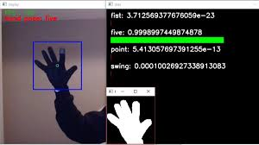
Swami keshvanand Institute of
Technology
Department of Information Technology
HAND GESTURE RECOGNITION
Presented by : Siddhesh Dosi
Roll no : 17ESKIT076
Guided By : Mr. Ashutosh Singh

Slide 2
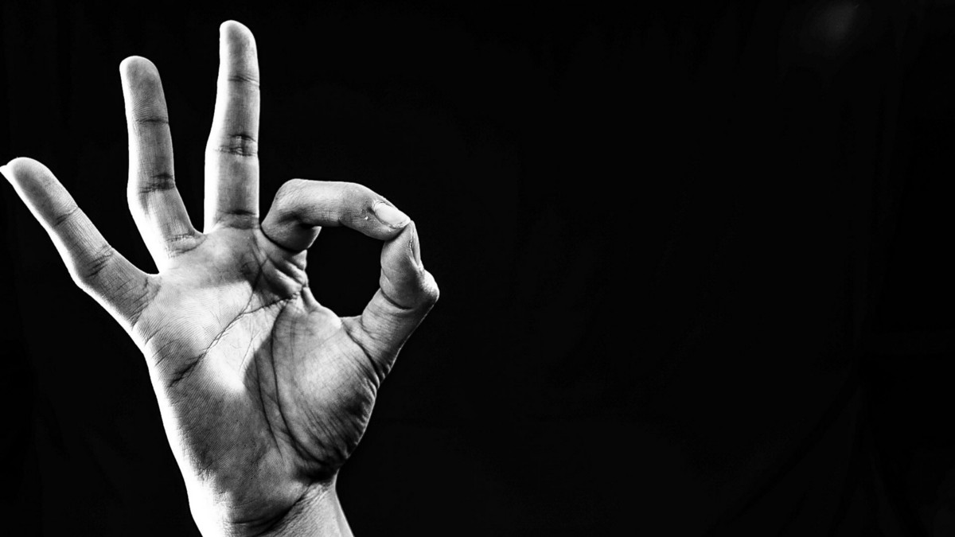
www.What_is_Gesture?.com
Non-Verbal communication
Exchange information
Or you can say,
“MOTION OF BODY THAT CONTAINS INFORMATION”
--Siddhesh

Slide 3
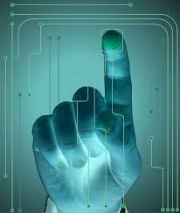
<h1>Bringing them to us..</h1>
<p>
Imagine yourself a deaf person, or suppose one of your friend is deaf.
How would you exchange feelings
or communicate?
Will you be able to deliver them
right
and easily?
</p>

Slide 4
While(Motivation)
{
Imagine when you are controlling the media player or a browser just with your hand gestures.
Communicating with hand movements.
Interaction problems with mouse, or the device is farther to you.
}

Slide 5
#include<Project Idea>
Desktop Application.
Converting SIGN language into SPEECH and convert TEXT to SIGN language.
Special Calculator using sign gestures.
Control Media Player using hand movement.
Enables HUMAN to INTERFACE with the MACHINE (HMI).

Slide 6
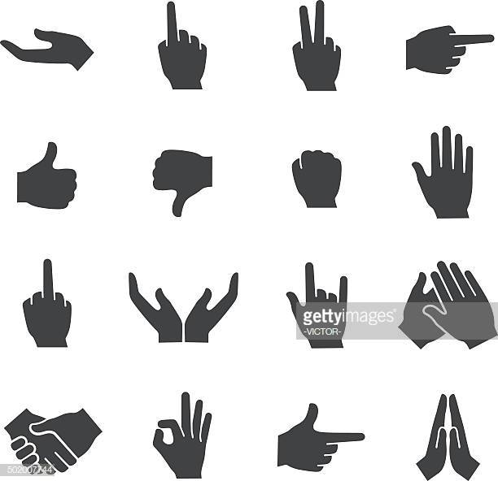
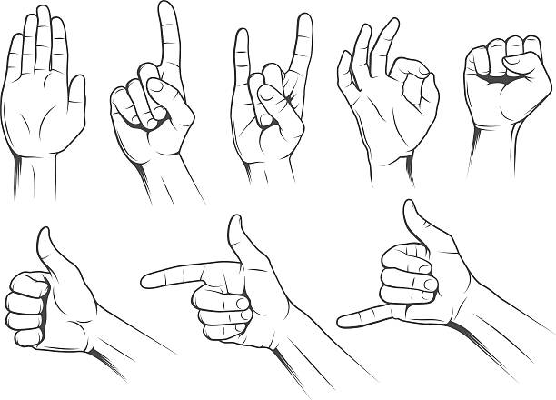
Technical_Overview.py
T00LS
Python
OpenCV
CNN
Speech to text conversion
pyAutoGui
IDE
Microsoft Visual Studio
Jupyter Notebook
Google Colab
OpenCV on MSV

Slide 7
Print(Challenges);
Lack of gesture language:
Different users make different hand gestures
Use of complex gestures is very hard to understand by the machine.
Robustness:
Many gesture recognition systems do not read motions accurately and optimally, due to factors like background light, high background noise, fast movement of gestures, etc.

Slide 8

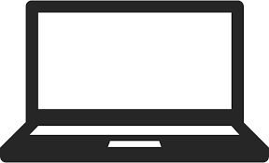
Import Project.Overview;
Sign
Speech/Text
Other features

Slide 9
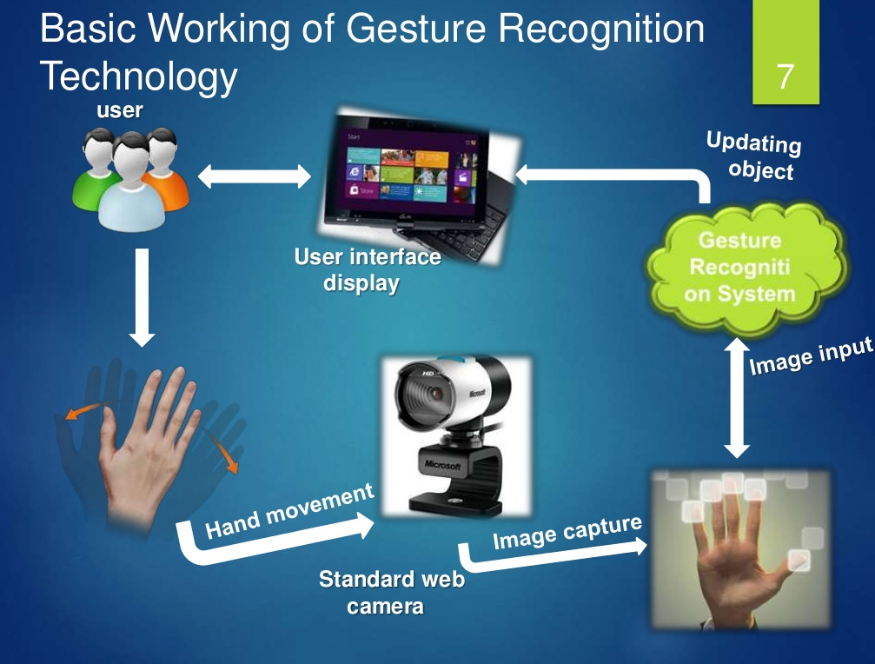
$ sudo Project Scenario

Slide 10
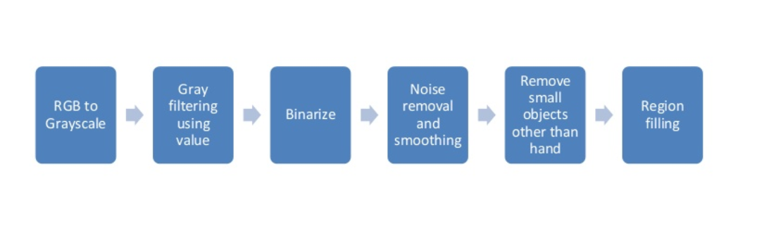
Project Scenario (contd.)
Pre-processing:

Slide 11
Home page:
Provide a user manual for some universal hand gestures
like back, select, home, help, etc.
Features options:
1. Calculator
This feature contains Gesture instructions for Calculator.
2. Sign to speech
3. Speech to sign
4. Media player control
5. Browser control

Slide 12
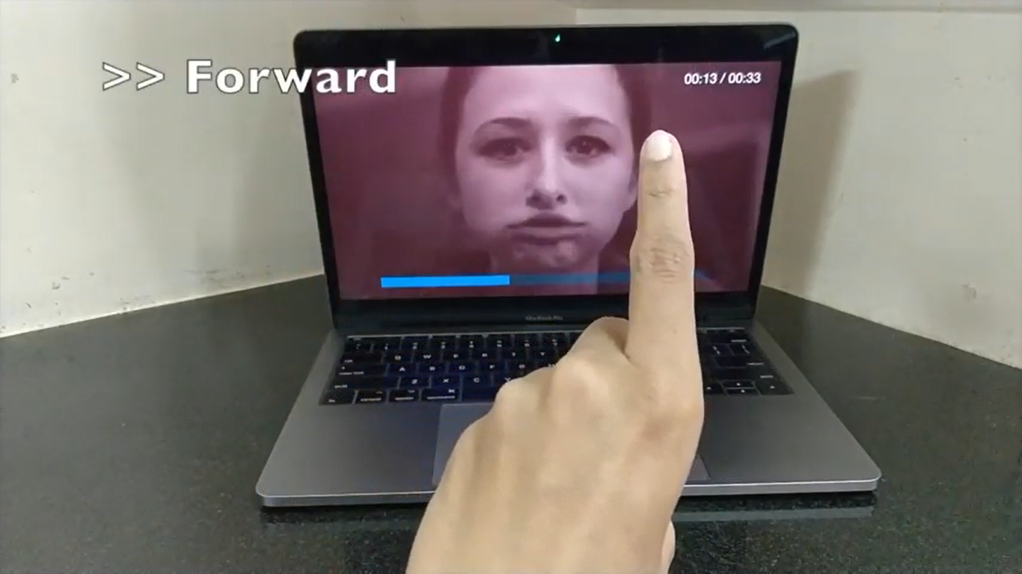
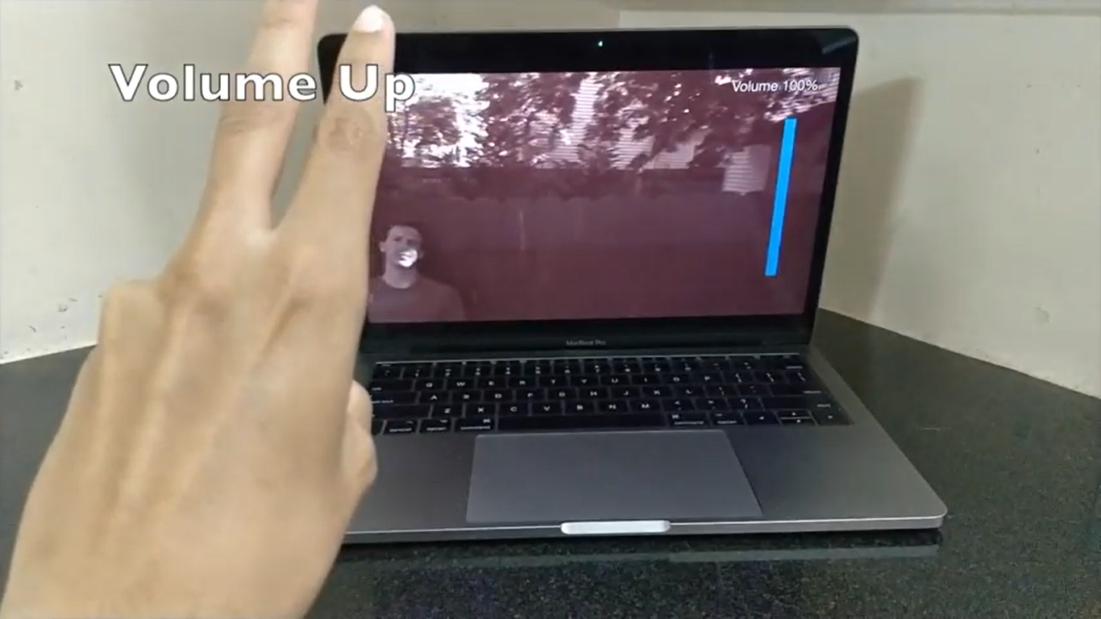
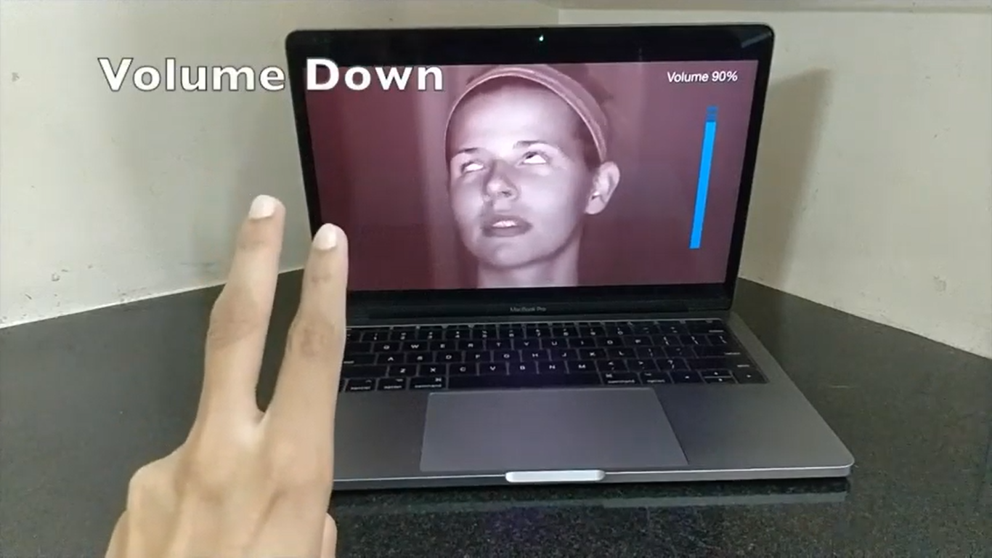
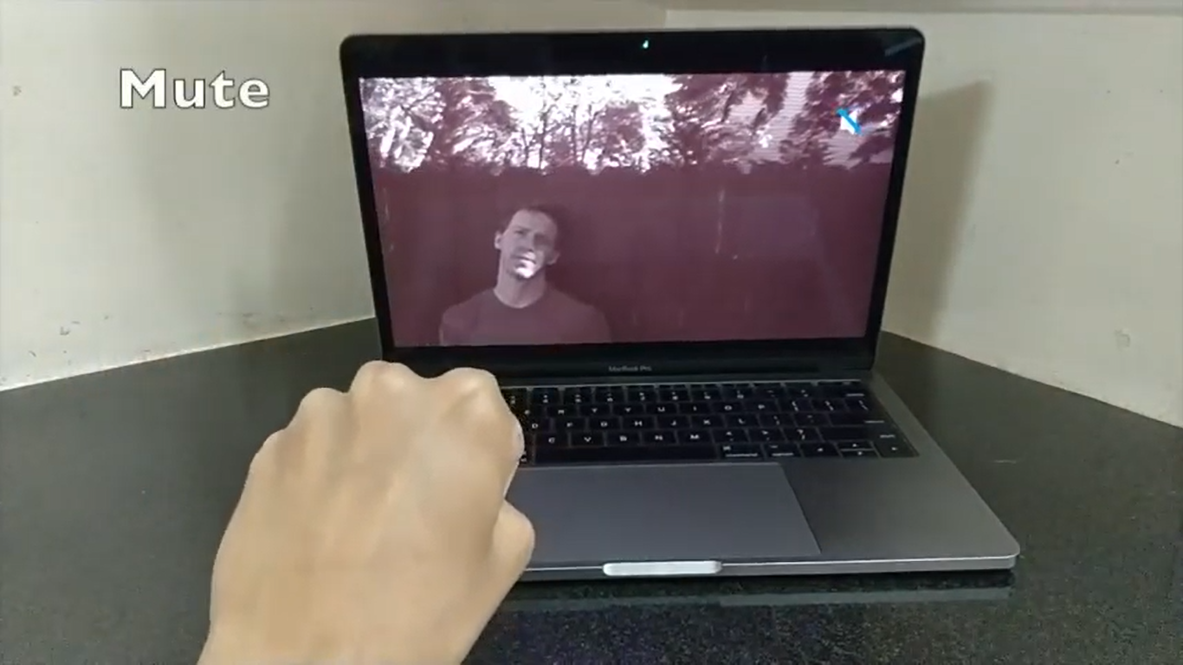
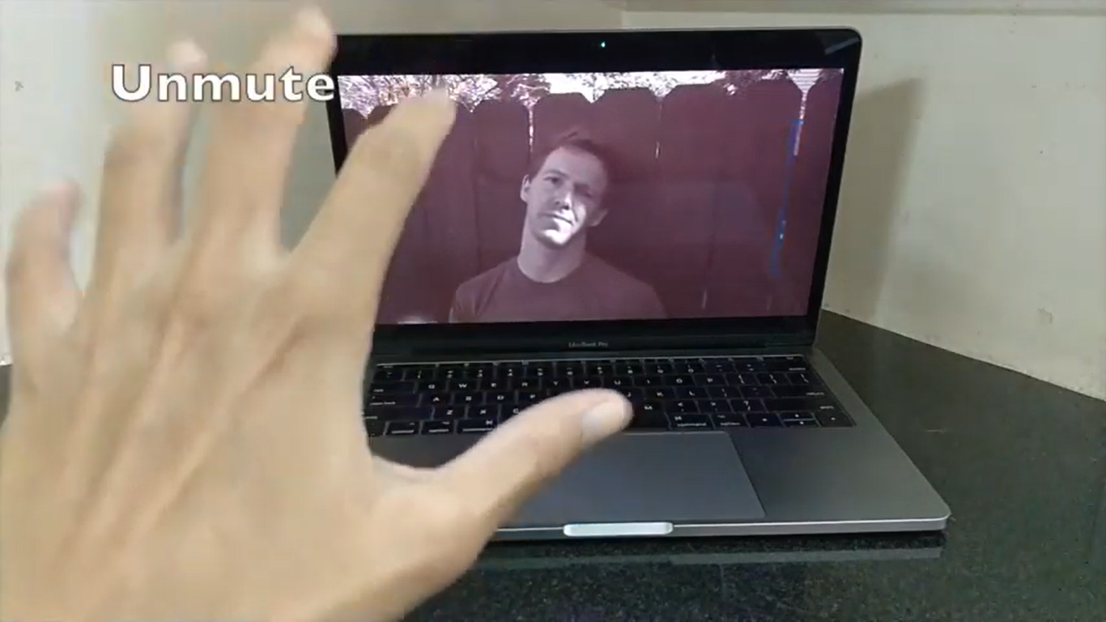

Slide 13
FROM proj_repo
SELECT conclusion;
We Presented The Implementation of a System That aims to Translate sign language (Hand Gestures) into speech (Sound).
In the future, we aspire to Complete software application that will be available commercially to users that have a fast Mobile, a camera, and speakers and cover all words in English sign language.

Slide 14
A Huge Thank you
To my guide/mentor : Mr. Ashutosh Singh
To my batch counsellor : Mrs. Poonam Varshney
And to all my team members at adHoc Networks
And to all who are listening this presentation..

